Slide 1













STELLA’S JOURNEY
team : ft_skypot

Slide 2









07
12
WHO WE ARE
HOW OUR IDEA CAME TO BE
ft_skypot

Slide 3
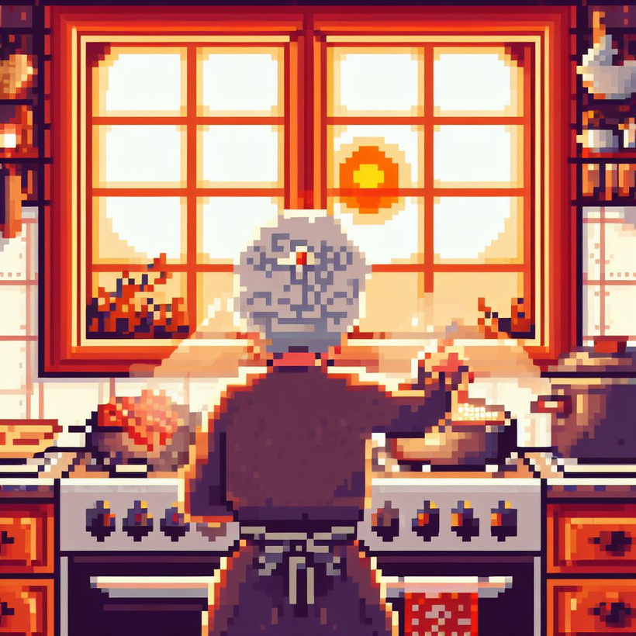
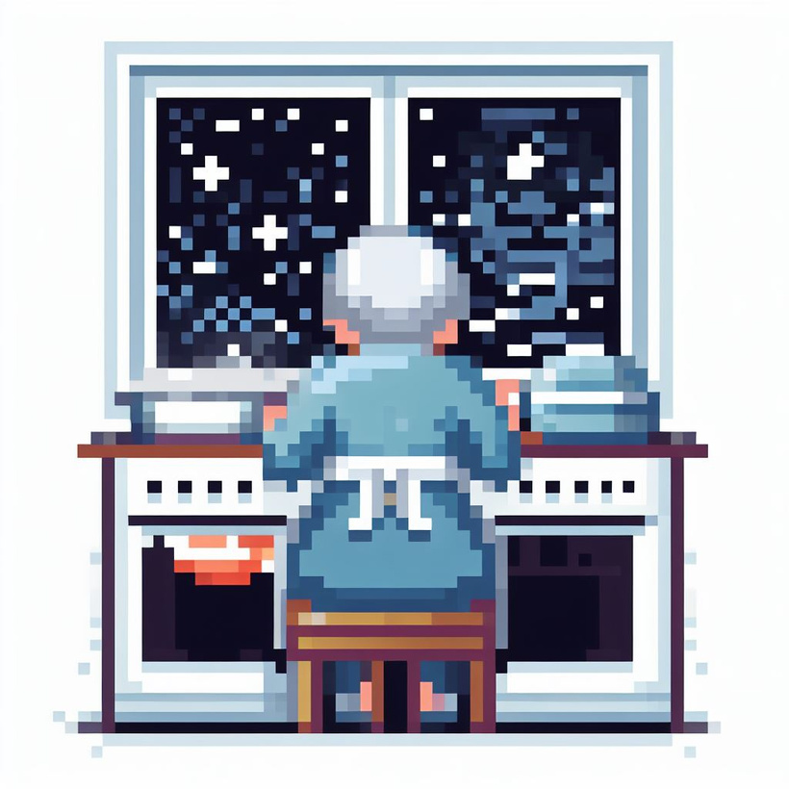






THE SKY IS IN YOUR POT

Slide 4




PLAYER 1
WHY GAMIFICATION IS THE KEY TO CAPTURE THE INTEREST OF YOUNG LEARNERS

Slide 5

HAVE YOU EVER STUDIED WITH BACKGROUND MUSIC?
back to realIty

Slide 6
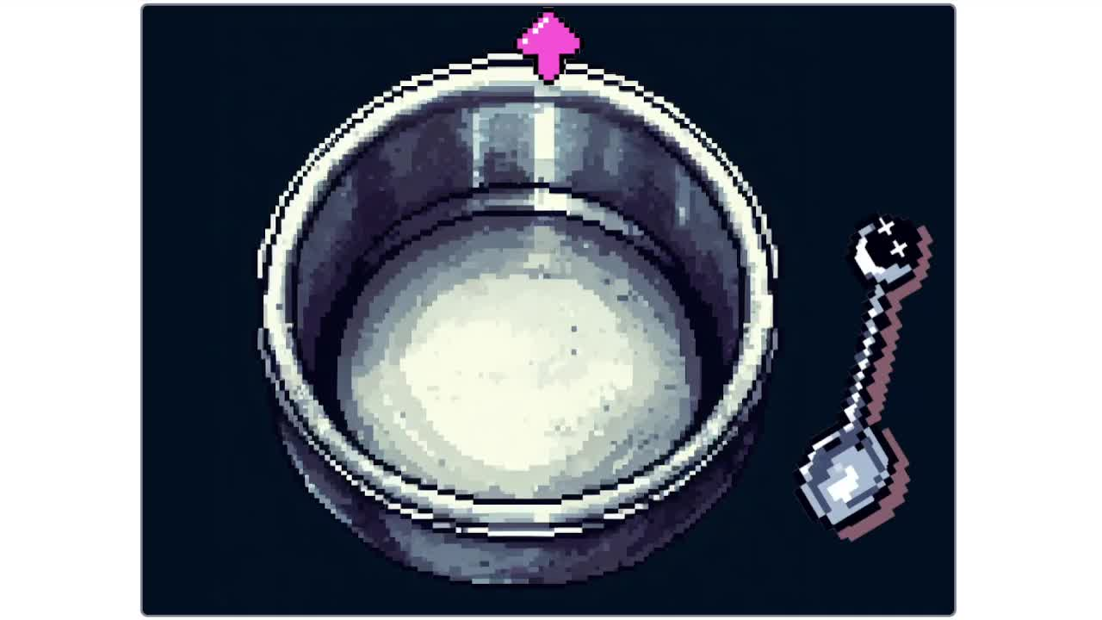

Slide 7





07
12
SOME ITEMS
spoon
the pot
recipe book
glasses
Tip: Use links to go to a different page inside your presentation.
How: Highlight text, click on the link symbol on the toolbar, and select the page in your presentation you want to connect.

Slide 8




07
12
SOME ITEMS
patatoes
garlic
onions
radio
Tip: Use links to go to a different page inside your presentation.
How: Highlight text, click on the link symbol on the toolbar, and select the page in your presentation you want to connect.

Slide 9







ACHIEVEMENTS

Slide 10






THANK YOU!

